Slide 1
CS2100 Tutorial 9
Sequential Circuits
Slides by Theodore, adapted from Prof. Aaron’s slides

Slide 2
Recap
K-maps
minterm and Maxterm
Boolean Algebra laws

Slide 3
Overview
Q1) Control values
Q2) Critical path / time calculation
Q3) Messing up inputs and hypotheticals

Slide 4
Q1.
Present state |  | Output | Flip-flop inputs |  | Next state
A | B | p = A⊕B’ | TA = A⋅B’ | DB = A’+B | A⁺ | B⁺
0 | 0
0 | 1
1 | 0
1 | 1
A⋅B'
T
Q
A
Clk
Q'
A⊕B'
p
1
0
1
0
1
A'+B
D
Q
B
0
0
1
0
1
Clk
Q'
0
1
0
0
0
1
0
1
1
1
Clock
/p
/0
0
/1
1
/0
/1
3
2

Slide 5
Q1.
(b) Assuming that the circuit is initially at state 0, what is the final state and the outputs generated after 3 clock cycles?
State 1; output: 100.
(c) A state is a sink if once the circuit enters this state, it never moves out of that state. How many sinks are there?
2 sinks: states 1 and 3.
(d) Which is likely an unused state in this circuit?
Likely to be state 3.
/p
/0
0
/1
1
/0
/1
3
2

Slide 6
Q2.
C'
J
Q
A
JA = C’; KA = C; JB = A; KB = 1; JC = A⋅B; KC = 0.
C
K
Q'
Present state |  |  | Next state |  |  | Flip-flop inputs
A | B | C | A⁺ | B⁺ | C⁺ | JA=C’ | KA=C | JB=A | KB=1 | JC=A⋅B | KC=0
0 | 0 | 0
0 | 0 | 1
0 | 1 | 0
0 | 1 | 1
1 | 0 | 0
1 | 0 | 1
1 | 1 | 0
1 | 1 | 1
A
J
Q
B
1
K
Q'
1
0
1
0
1
0
1
0
0
0
0
0
1
1
0
0
0
1
0
1
0
1
1
1
1
0
1
0
1
0
1
0
0
1
0
1
0
1
0
1
0
0
0
0
1
1
1
1
1
1
1
1
1
1
1
1
0
0
0
0
0
0
1
1
0
0
0
0
0
0
0
0
A·B
J
Q
C
0
K
Q'
Clock
1
2
7
6
3
Is the circuit self-correcting?
Yes.
5
4
0

Slide 7
Q3.
Redesign circuit in Q2 using only T flip-flops.
TA
B
Present state |  |  | Next state |  |  | Flip-flop inputs
A | B | C | A⁺ | B⁺ | C⁺ | TA | TB | TC
0 | 0 | 0
0 | 0 | 1
0 | 1 | 0
0 | 1 | 1
1 | 0 | 0
1 | 0 | 1
1 | 1 | 0
1 | 1 | 1
1
2
X
0
0
1
A
0
1
X
0
X
0
1
0
1
0
1
X
X
0
0
0
1
1
0
X
X
1
0
1
0
1
1
X
X
0
1
0
0
1
0
X
X
0
1
1
1
1
1
X
X
0
0
0
0
0
1
X
C
6
3
TA = A⋅C + A'⋅C’ = AC
5
4
TB
B
X
0
1
1
A
1
1
X
1
TB = A+B
C
TC
B
X
0
0
0
A
0
0
X
1
TC = A⋅B
C
3 logic gates: XNOR, OR, AND.

Slide 8
Q4.
Current state |  |  |  | Next state |  |  |  | Flip-flop inputs
A | B | C | D | DA=A⁺ | B⁺ | C⁺ | D⁺ | TB | TC | JD | KD
0 | 0 | 0 | 0 | X | X | X | X | X | X | X | X
0 | 0 | 0 | 1 | 0 | 0 | 1 | 1
0 | 0 | 1 | 0 | 0 | 1 | 0 | 0
0 | 0 | 1 | 1 | 0 | 1 | 0 | 1
0 | 1 | 0 | 0 | 0 | 1 | 1 | 0
0 | 1 | 0 | 1 | 0 | 1 | 1 | 1
0 | 1 | 1 | 0 | 0 | 0 | 0 | 1
0 | 1 | 1 | 1 | 1 | 0 | 0 | 1
1 | 0 | 0 | 0 | X | X | X | X | X | X | X | X
1 | 0 | 0 | 1 | 1 | 0 | 1 | 1
1 | 0 | 1 | 0 | X | X | X | X | X | X | X | X
1 | 0 | 1 | 1 | 1 | 1 | 0 | 1
1 | 1 | 0 | 0 | X | X | X | X | X | X | X | X
1 | 1 | 0 | 1 | 1 | 1 | 1 | 1
1 | 1 | 1 | 0 | X | X | X | X | X | X | X | X
1 | 1 | 1 | 1 | 0 | 0 | 1 | 0
1
3
5
7
9
0
1
X
0
6
4
2
15
13
11
1
1
0
X
1
1
X
0
0
1
0
X
0
1
X
0
1
1
1
X
1
1
X
0
Excitation table for JK Flip-flop
0
1
X
0
DA = A∙B' + A∙C’ + A'∙B∙C∙D
TB = C
1
1
X
0
TC = A' + B' + C'
JD = B∙C
0
1
X
0
KD = A∙B∙C
1
0
X
1

Slide 9
Q4.
Current state |  |  |  | Next state |  |  |  | Flip-flop inputs
A | B | C | D | DA=A⁺ | B⁺ | C⁺ | D⁺ | TB | TC | JD | KD
0 | 0 | 0 | 0 | X | X | X | X | X | X | X | X
0 | 0 | 0 | 1 | 0 | 0 | 1 | 1 | 0 | 1 | X | 0
0 | 0 | 1 | 0 | 0 | 1 | 0 | 0 | 1 | 1 | 0 | X
0 | 0 | 1 | 1 | 0 | 1 | 0 | 1 | 1 | 1 | X | 0
0 | 1 | 0 | 0 | 0 | 1 | 1 | 0 | 0 | 1 | 0 | X
0 | 1 | 0 | 1 | 0 | 1 | 1 | 1 | 0 | 1 | X | 0
0 | 1 | 1 | 0 | 0 | 0 | 0 | 1 | 1 | 1 | 1 | X
0 | 1 | 1 | 1 | 1 | 0 | 0 | 1 | 1 | 1 | X | 0
1 | 0 | 0 | 0 | X | X | X | X | X | X | X | X
1 | 0 | 0 | 1 | 1 | 0 | 1 | 1 | 0 | 1 | X | 0
1 | 0 | 1 | 0 | X | X | X | X | X | X | X | X
1 | 0 | 1 | 1 | 1 | 1 | 0 | 1 | 1 | 1 | X | 0
1 | 1 | 0 | 0 | X | X | X | X | X | X | X | X
1 | 1 | 0 | 1 | 1 | 1 | 1 | 1 | 0 | 1 | X | 0
1 | 1 | 1 | 0 | X | X | X | X | X | X | X | X
1 | 1 | 1 | 1 | 0 | 0 | 1 | 0 | 1 | 0 | X | 1
1
3
5
7
9
(0)
0
1
0
0
1
0
0
6
4
2
15
13
11
0
8
10
12
14
Is the circuit self-correcting?
Yes
(1)
0
1
0
0
1
0
0
DA = A∙B' + A∙C’ + A'∙B∙C∙D
(1)
1
0
0
1
1
0
0
TB = C
TC = A' + B' + C'
(1)
1
1
0
0
1
0
0
JD = B∙C
KD = A∙B∙C
(0)
0
1
1
1
0
1
1

Slide 10
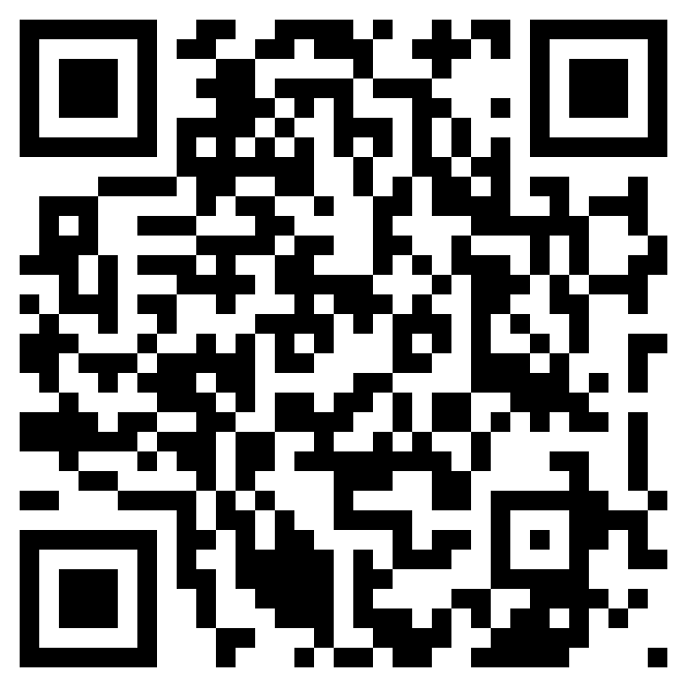
End of Tutorial 7
Slides uploaded on github.com/theodoreleebrant/TA-2425S1
Email: theo@comp.nus.edu.sg
Anonymous feedback:
bit.ly/feedback-theodore
(or scan on the right)
(Also reminder for me to take attendance)

